Slide 1

AMATS and Vision Zero

Slide 2

What is Vision Zero?

Slide 3
What is Vision Zero?
Vision Zero is a strategy to eliminate traffic fatalities and severe injuries among all road users, and to ensure safe, healthy, equitable mobility for all.
The Vision Zero approach recognizes that people will sometimes make mistakes, so the road system and related policies should be designed to ensure those inevitable mistakes do not result in severe injuries or fatalities.
Vision Zero is not a slogan, not a tagline, not even just a program. It is a fundamentally different way to approach traffic safety.

Slide 4
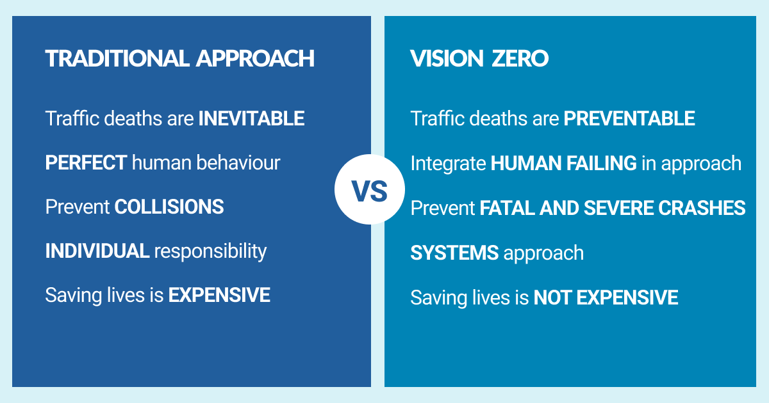
Traditional Approach vs Vision Zero Approach

Slide 5
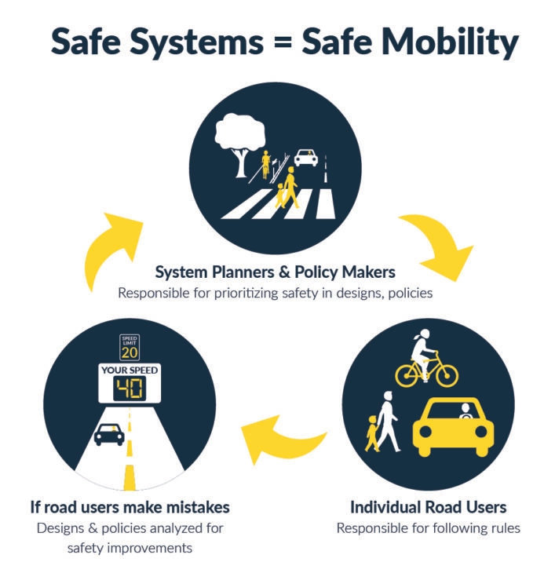
Committing to Vision Zero is Creating a New Safety Culture

Slide 6
9 Components of a Strong Vision Zero Commitment
1) Political Commitment
2) Multi-Disciplinary Leadership
3) Creating an Action Plan
4) Equity
5) Cooperation and Collaboration
6) Safe System Approach
7) Data-Driven
8) Community Engagement
9) Transparency

Slide 7

Funding Opportunities

Slide 8

Safe Streets for All (SS4A) is the grant program behind Vision Zero.
$1 billion/year directly supporting Vision Zero planning and implementation efforts.
$5 billion total funding.

Slide 9
Step 1: An official and public commitment to Vision Zero by approving Resolution 2022-16
1) Political Commitment
2) Multi-Disciplinary Leadership
3) Develop an Action Plan
4) Equity
5) Cooperation and Collaboration
6) Safe System Approach
7) Data-Driven
8) Community Engagement
9) Transparency

Slide 10
Future Step 2: Assemble Leadership Committee
An official Vision Zero Taskforce (or Leadership Committee) will be created and charged with leading the multi-disciplinary efforts for Vision Zero.
1) Political Commitment
2) Multi-Disciplinary Leadership
3) Develop an Action Plan
4) Equity
5) Cooperation and Collaboration
6) Safe System Approach
7) Data-Driven
8) Community Engagement
9) Transparency

Slide 11
Future Step 3: Develop a Vision Zero Action Plan.
A Vision Zero Action Plan is where we move from vision to action.
The Vision Zero Action Plan should lay out strategies focused on managing speeds and designing roadways for safety and equity.
1) Political Commitment
2) Multi-Disciplinary Leadership
3) Develop an Action Plan
4) Equity
5) Cooperation and Collaboration
6) Safe System Approach
7) Data-Driven
8) Community Engagement
9) Transparency

Slide 12
At this time AMATS recommends approval of Resolution 2022-16 which adopts a “Vision Zero” goal of zero fatalities and serious injuries by 2050.
Questions?

